Slide 1
Session #1:
Markers of Discipleship
Notes:
Welcome to Session 1: Markers of Discipleship. This session invites you to reflect on foundational elements of Christ-centered discipleship.

Slide 2
Self-Reflection: When have you been discipled well?
• What helped you grow in your faith during that time?
• How can these lessons inform how you disciple others today?

Slide 3
This is the essence of the church: a people who find their identity in the arms of God (communion), rallied around tables welcoming each other (community) and sent out into the world with serving hands (co-mission)."!
- Woodward & White (The Church as Movement: Starting and Sustaining Missional-Incarnational Communities)
Notes:
In this session, you'll reflect on the foundational framework of ecclesia, outlined in E.K. Strawser’s Centering Discipleship. At the heart of ecclesia are three essential elements:
Communion: Discipleship is not about assimilating into church culture or simply participating in activities. It is about living out the fruit of our union with Christ.
Community: Discipleship involves experiencing firsthand the beauty of being sanctified through authentic relationships with one another.
Co-Mission: Discipleship calls us to orient every member toward participating with God in the renewal of our neighborhoods and communities.
Pause and reflect:
Which of these three elements feels most fully expressed in your current ministry context?
Which element could be strengthened?
How might you deepen Communion, Community, or Co-Mission within your congregation?

Slide 4
Christlike praxis is about listening and doing – living into the praxis of self-giving love as a sent community.
Leadership | Centered Discipleship | Peripherical discipleship
Emphasis on: | Imitation (discipleship) | Instruction (sermon)
Moving people to: | Community around them | Sunday worship service
Vision for: | Movement | Church
Notes:
When Jesus called his followers to make disciples, he was not inviting them into a systemic program but into a new way of life.
Discipleship is a way of living, not merely a set of activities.
Take time to read the table presented.
Reflection Prompts:
What fruit should we be looking for that marks a true disciple of Jesus? (Hint: Focus on the quality of life together and identity rooted in Christlikeness, not just participation in programs.)
Reflect on the difference between methods of discipleship (such as classes and small groups) and indicators of discipleship (such as the fruit of the Spirit).
How does this distinction challenge or affirm your current discipleship practices?

Slide 5
The Makers of a Mature Disciple:
Discipleship is about maturing in Christ.
Four essential marks of being transformed by Christ
Character
Theology
Wisdom
Missional Living
Notes:
Discipleship shapes the whole person, and maturity can be seen in four distinct areas:
Maturity of Character: Evidence of Holy Spirit transformation, seen through the fruit of a person's life.
Maturity of Theology: A deep and ongoing love for knowing God and being known by God—growing in the "mind of Christ."
Maturity of Wisdom: Responding as Christ would, developing skills to navigate life faithfully and well.
Maturity of Mission: Living a sent life, actively participating in God's work in the world.
Reflection Prompts:
In your current discipleship environment, which area of maturity do you see most clearly nurtured?
Which area might need more intentional focus?
How could your ministry create spaces where all four areas of maturity are formed?

Slide 6
Discipleship is not:
Type | Characteristic
supervision | Structure > Relationship
friendship | Structure < Relationship
counseling | Inward Focused > Outward focused
trainings | Inward Focused < Outward focused
Which of these disguises do you find most challenging to avoid in
your discipleship?
Notes:
We have just reflected on what true discipleship is. Now, it’s important to recognize what discipleship is not. While these aspects may have a place within discipleship, they cannot define it on their own:
Supervision: Discipleship is not a contractual relationship based on control or forced accountability.
Friendship: Discipleship is more than casual companionship or shared interests; it is a transformational relationship centered on Christ.
Counseling: Discipleship is not simply addressing individual needs according to personal terms; it is about shaping us according to God’s call.
Training: Discipleship is not just about acquiring skills—it is about being formed in character and Christlikeness.
Reflection Prompts:
Which of these distortions do you see most often in your ministry context?
How can you move your discipleship efforts beyond these limited models toward transformational Christ-centered relationships?

Slide 7
Discipleship Structure
Centered Set
Bounded Set
movement toward Jesus
Creating a space for inclusivity & participation in a missional community
clear commitments and practices within a smaller discipleship core
Notes:
Discipleship maturity is supported by a structure that holds both Centered Set and Bounded Set dynamics:
Centered Set: Focused on movement toward Jesus. It creates an inclusive environment where people can explore faith, participate in community life, and take steps toward Christ. (Example: attending worship gatherings, joining Hope Avenue activities.)
Bounded Set: Focused on clear commitments and shared practices within a smaller discipleship core. This depth is crucial for cultivating maturity. (Examples: prayer gatherings before worship, covenantal spiritual practices shared with 3–5 trusted people, serving together regularly.)
Key Insight: The broader church (centered) welcomes and invites, while the discipleship core (bounded) forms mature followers of Jesus through commitment, accountability, and shared spiritual rhythms. Both are essential.
Reflection Prompts:
In your current ministry context, what practices help create a centered set where people can take first steps toward Jesus?
What practices build a bounded set of committed disciples growing deeper in their faith?
How could you make “next steps” clearer for those moving from centered experiences into bounded discipleship (just like using a turn signal when driving)?

Slide 8
Discipleship Structure
Centered Set
Bounded Set
Create Open Pathways
Practice Hospitality
Storytelling and Witness
Covenantal Relationships
Intentional Practices
Boundaries with Purpose
Notes:
In this section, you'll explore how a healthy discipleship structure supports the maturing of followers of Jesus by holding together two important dynamics: Centered Set and Bounded Set.
Centered Set: Focused on movement toward Jesus, creating an inclusive environment where people are welcomed, can explore faith, and take steps toward Christ through all Avenue activities (e.g., worship gatherings, Hope Avenue engagement).
Example: We gather corporately for worship services, inviting all to participate and move toward Jesus.
Bounded Set: Focused on clear commitments and practices within a smaller, more intentional discipleship core.
Examples: Prayer time before worship gatherings, committing to seasonal spiritual practices with a trusted group of 3–5, serving together monthly beyond just gathering.
Additional models: Programs like AA or covenant groups such as Jeff’s “shield group” offer deeper, covenantal relationships around growth and accountability.
Key Insight: There is a need to recover covenant-type relationships within the Church. While missional communities create space for exploration (centered set), the depth of discipleship grows best in bounded relationships of commitment and intentional practice.
Practical Wisdom: Always have a clear “next step” available for participants, just like using a turn signal to guide someone following you. (Example: Hope Avenue Champions ensuring that announcements include invitations to a next connection point.)
Reflection Prompts:
Where does your ministry currently create an inclusive space for people to move toward Jesus (centered set)?
Where do you intentionally call people into deeper, covenantal discipleship commitments (bounded set)?
How clear are the “next steps” for movement from exploration to deeper engagement in your context?

Slide 9
Centered & Bounded Sets

Slide 10
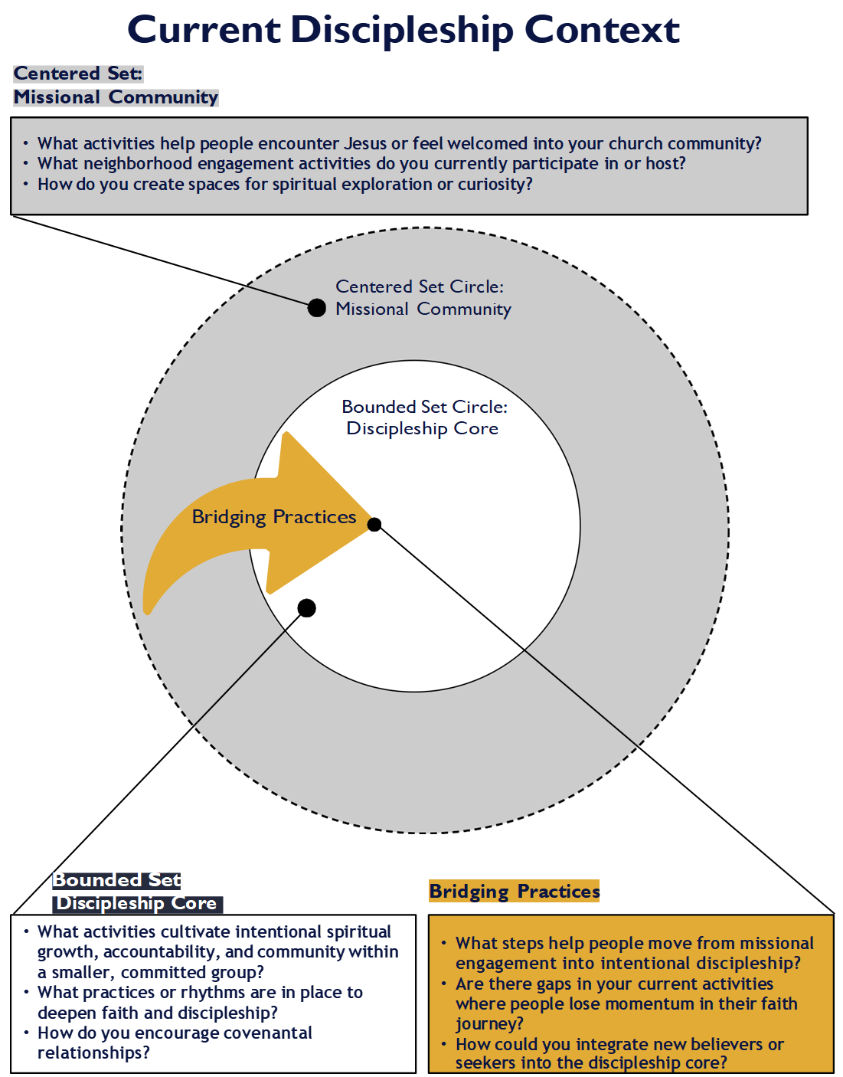
Notes:
After review the next few example slides you will complete the activity on your own.

Slide 11
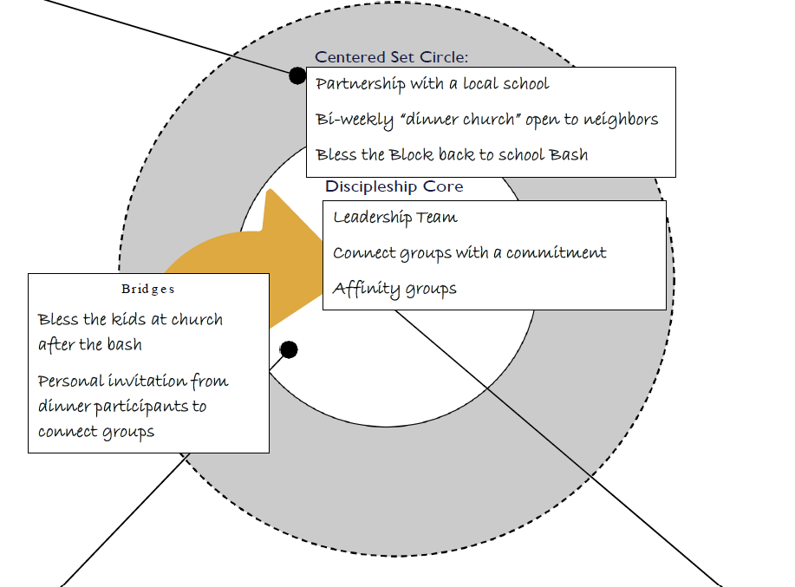
GC City A
Context: small diverse church in a gentrifying city neighborhood.
Notes:
Let’s look at the GC City A example. This is a small, diverse church in a gentrifying neighborhood that’s working intentionally with both centered and bounded set practices.
In the centered set, they focus on welcoming and missional engagement—like partnering with a local school, hosting a bi-weekly Dinner Church for neighbors, and holding a back-to-school bash called "Bless the Block."
In the bounded set, they build deeper commitment through a Leadership Team, Connect Groups with commitment, and Affinity Groups.
Bridging practices connect the two—like blessing kids after the community event and personally inviting neighbors into deeper discipleship through connect groups.
This example shows how having both welcoming spaces and committed groups—and clear bridges between them—creates a healthy, Christ-centered environment where people can grow.

Slide 12
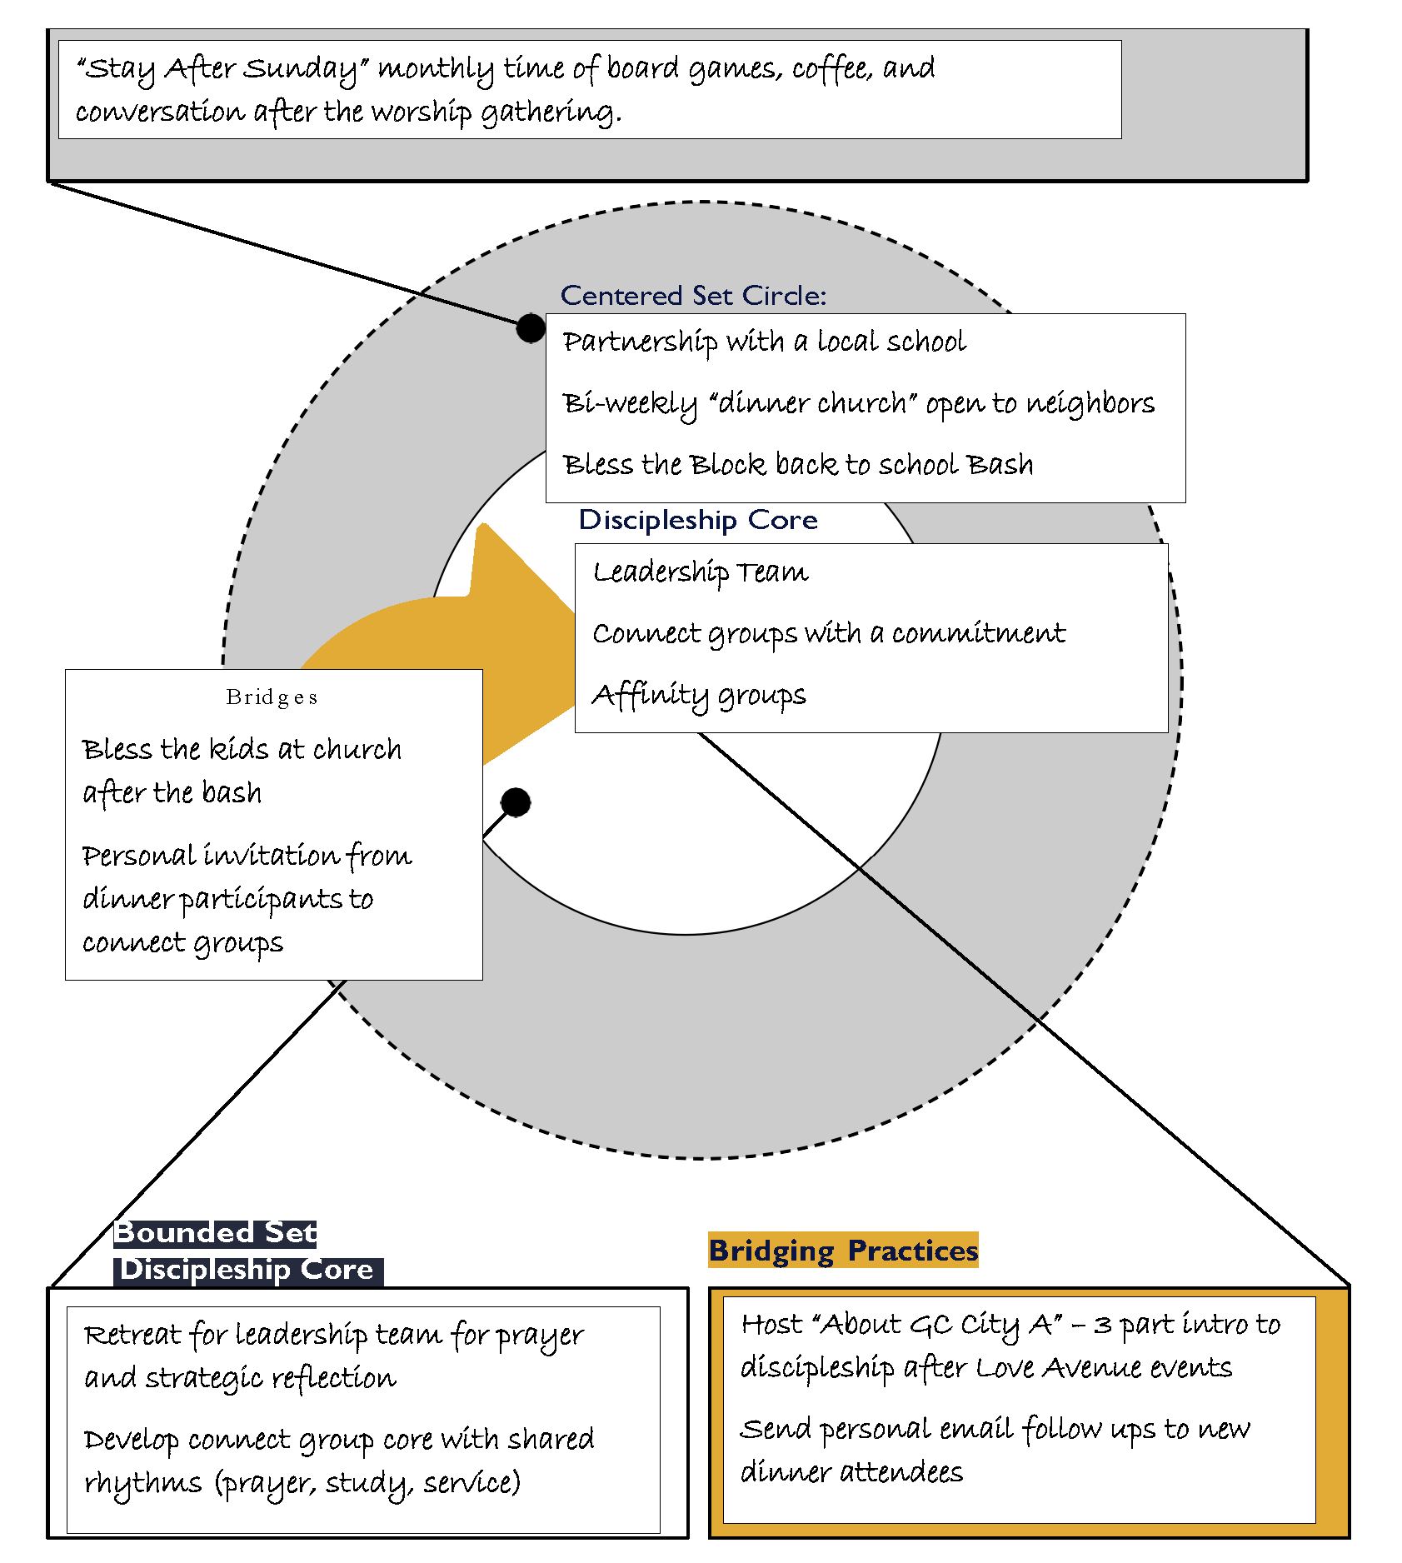
GC City A
Context: small diverse church in a gentrifying city neighborhood.
Notes:
Let’s take a closer look at GC City A and some of the strategies they’re building onto their current practices.
The activities inside the circles—like partnerships with schools, Dinner Church, leadership teams, and connect groups—reflect what they’re already doing to cultivate both Centered and Bounded Sets.
But notice the boxes outside the circles. These represent new strategies they are intentionally developing to strengthen their discipleship framework:
"Stay After Sunday": a monthly casual gathering after worship to build deeper community and connections.
Leadership Retreats: setting aside time for their leadership core to pray, reflect, and plan strategically for the next season of growth.
Developing Core Rhythms in Connect Groups: establishing shared practices like prayer, study, and service to deepen discipleship.
Hosting an "About GC City A" Series: a three-part introduction to help newcomers understand the community and next steps toward discipleship.
Personal Follow-Ups: sending intentional email follow-ups to Dinner Church attendees to invite them into deeper connection.
These additions show that healthy discipleship isn’t static — it grows through thoughtful next steps that strengthen both community life and commitment to Christ.

Slide 13
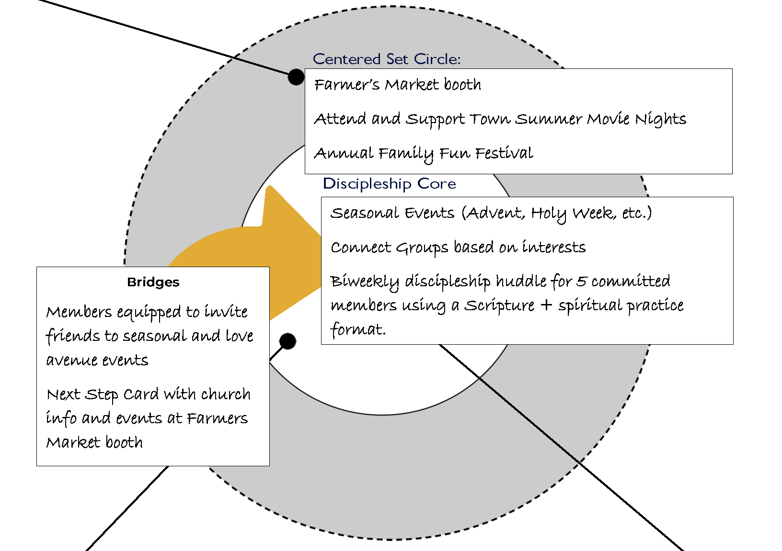
GC B Town
Context: middle income, commuter church across several areas.
Notes:
Now let's take a look at GC B Town — a middle-income, commuter church spread across several areas.
You can see that their Centered Set Circle focuses on meeting people where they already are:
They host a booth at the local Farmer’s Market,
Attend and support Town Summer Movie Nights,
And invite the community to their Annual Family Fun Festival.
In the Discipleship Core, they’re creating deeper spaces for formation:
They host Seasonal Events tied to important times like Advent and Holy Week,
They offer Connect Groups based on shared interests,
And they’ve formed a biweekly discipleship huddle for a small group of committed members using Scripture and spiritual practices.
Their Bridging Practices help make the transition between the two:
Members are equipped to invite friends to seasonal and Love Avenue events,
And at the Farmer’s Market booth, they hand out Next Step Cards with clear information on church activities and upcoming gatherings.
GC B Town shows how even in a commuter context, you can intentionally create connection points that lead toward deeper discipleship.

Slide 14
GC B Town
Context: middle income, commuter church across several areas.
Notes:
Now let’s look at some of the shifts that GC B Town is building onto their current practices to strengthen their discipleship pathway.
You’ll see that they are adding a few key strategies outside the circles:
They are working to make their worship gatherings even more intentionally welcoming, using simple language and creating space for spiritual seekers.
In the Bounded Set Discipleship Core, they are launching a Prayer Partner initiative to deepen relationships in their interest-based connect groups.
And for Bridging Practices, they are offering a new three-week "Come and See" conversation series after events, where people can explore faith and next steps more intentionally.
These additions show how GC B Town is not only continuing their centered and bounded set work but also thoughtfully building stronger bridges to help people move into deeper discipleship relationships.

Slide 15
Notes:
Now it’s time to engage with the activity.
Instructions:
Turn to page 3 of your participant guide.
Use the guiding questions there to help you identify your current practices and record them on page 4.
Centered Set practices go inside the gray circle (missional, welcoming, exploring faith).
Bounded Set practices go inside the white circle (covenantal, committed discipleship).
Bridging Practices can be listed on the left side of the page if it's difficult to fit them in the gold arrow (activities that move people from exploring to deeper discipleship).
Next:
After brain-dumping what you’re currently doing, use the blank boxes to dream.
What shifts, new initiatives, or strengthening practices could you implement to deepen your centered set, bounded set, and bridging work?
Encouragement:
Even if these terms are new to you, you are already practicing many of these dynamics!
Take a moment to celebrate what you’re already doing — and allow yourself to imagine what could grow even stronger.

Slide 16
Reflection Questions
Which area—centered set, bounded set, or bridging practices—feels strongest in your current ministry context? Which area needs more intentional development?
What small shifts or new practices could you introduce in the next three months to strengthen your congregation’s movement toward deeper discipleship?
How might your leadership team or connect groups partner with you to create clear next steps for people moving from missional engagement to committed discipleship?

Slide 17
Next Steps:
Prioritize a Bridging Practice – What is one Bridging Practice you could focus on in the next three months? How can you implement it with your team?
Continue Learning – Read Part 2: Developing a Discipleship Pathway (Chapters 4-6) before our next session and reflect on how it applies to your ministry.
Engage & Share – Comment on the book club posting with your takeaways and next steps.
Notes:
Thank you for taking the time to invest in this important work of centering discipleship in your ministry. Remember, small intentional shifts can create powerful momentum toward a healthier, more Christ-centered culture.
As you move into the next steps:
Prioritize just one Bridging Practice you can implement with your team.
Keep learning and reflecting as you read Part 2 of Centering Discipleship.
And don’t forget to engage and share your insights with others — we grow stronger together!
We’re excited to see how God continues to lead and shape your community as you live out the beautiful calling of making disciples.

Slide 18
Session #1:
Markers of Discipleship

