Slide 1
Session # 2
Developing a Discipleship Pathway

Slide 2
Reflect
Name a shift or addition you’ve made to your centering, bounded, or bridging practices.
Discipleship in your congregation:
Where are you seeing movement toward Jesus?
What feels strong or vibrant?
What still feels unclear or stuck?
Notes:
We’re building on the foundational work you did in Session 1 around:
One Centered Set practice (missional/inclusive space)
One Bounded Set practice (discipleship/intentional core)
One Bridging practice (or gap)
And the describe discipleship in your congregation.
Thank you for taking the time to reflect. What you just named gives us a real-time picture of what discipleship already looks like in your context—and where there’s space for growth.

Slide 3
From Recipes to Local Cuisine
Why One-Size-Fits-All Doesn't Work
Discipleship is not a copy-paste model
We need both:
  Universal practices rooted in Scripture and Christ
  Local expressions that reflect your community's context
Think local cuisine, not national franchise
Notes:
Not every discipleship model works in every context.
While the ingredients are universal, the recipe must be local.
Strawser warns against importing discipleship models that may be polished but disconnected from the lived experience of your congregation.
She critiques:
Discipleship models that go untested in local space
One-size-fits-all tools based on the designer’s experience
Instead, she invites us to contextualize by—
listening to our people
Observing what’s forming them
shaping something faithful to both Jesus and the culture we’re in.
Strawser calls us to move from prefabricated systems to contextual discipleship—discipleship that feels like it was made in your own kitchen.
Ask: How does our church worship?
How do we relate?
What metaphors do we live in?
That’s where discipleship becomes tangible.

Slide 4
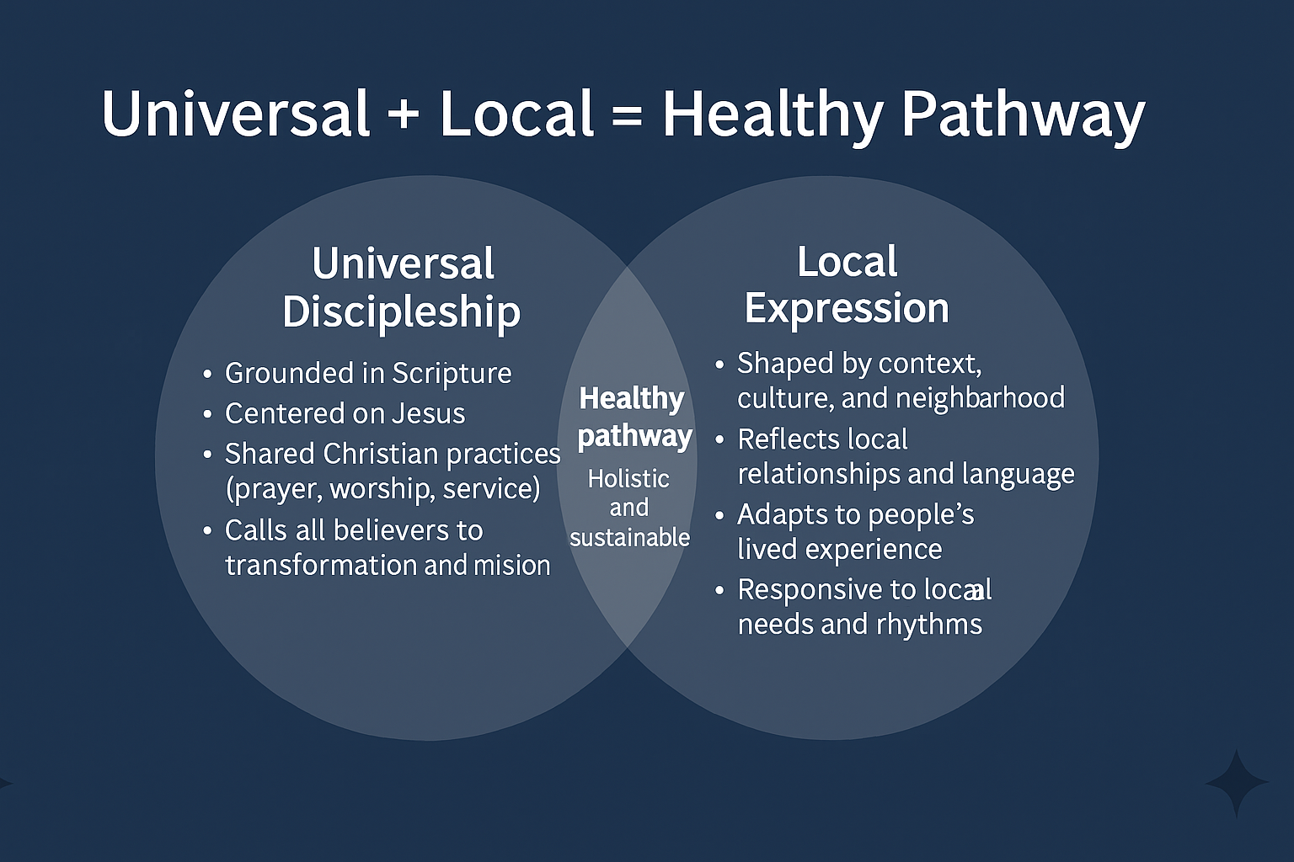
Spiritually rooted and culturally aware
Holistic and sustainable
Disciples formed in real life, not just programs
Notes:
Strawser makes it clear that discipleship cannot be reduced to a franchised model. It’s not enough to be ‘biblical’ if we’re not also contextual.
The healthiest pathways hold together two essential truths.”
Left Circle: Universal Discipleship
Rooted in the way of Jesus
Anchored in Scripture, spiritual disciplines, communal life, and mission
Shared practices like prayer, repentance, justice, and love
Right Circle: Local Expression (LOVE AVENUE TOOLKIT MAPPING YOUR NEIGHBORHOOD)
Practices shaped by your community’s story, needs, and culture
Adapted to language, literacy, pace, and the relational makeup of your people
Informed by listening to those being formed
Center (Healthy Pathway):
“Where these overlap, we find real transformation—discipleship that is Christ-centered and locally credible.”

Slide 5
What Does Maturity Look Like?
Start with the end in Mind:
What does Christlikeness look like in your neighborhood?
What do you want people to be able to do, say, or live out as they grow in faith?
Who already models spiritual maturity?
Notes:
Before we design a pathway, we have to define the destination.
What does Christlike maturity look like in your context—not theoretically, but in the real lives of your people?
Strawser encourages us to move beyond generic traits and ask:
What character traits, theological grounding, or missional instincts do you want to see?
Who already reflects these traits in your church?
How did they grow? What shaped them?
We’re not inventing discipleship—we’re naming what God is already growing and designing toward more of that.

Slide 6
Essential Ingredients of Any Pathway
Connect people to Scripture
01
Encourage imitation of Jesus
02
Engage in community and mission
03
Lead to praxis (practice and real life application)
04
Notes:
Whatever format your discipleship practices take—a group, a class, a meal, a one-on-one—they should embody these core ingredients.
If a tool is missing all four, it may not be forming disciples.
Whatever form your discipleship tools take, Strawser says they should always contain these four ingredients. Without them, we may be creating participation—but not formation.
1. Connect to Scripture
Not just learning Scripture, but letting it shape our values, language, and imagination.
2. Imitation of Jesus
Inviting people to pattern their lives after Jesus, not just talk about Him.
3. Community + Mission
Discipleship is never solo. It always draws us deeper into relationships and outward into mission.
4. Praxis (Practice + Application)
If there’s no real-world outflow, it’s not discipleship—it’s content consumption.
Example:
A mentoring relationship that uses a short Scripture reflection, shared mission engagement, and mutual accountability. It’s simple—but it’s forming.

Slide 7
The Journey of Discipleship
What a pathway needs to be.
Elements | Description
Meaningful | Clear why behind each step; spiritually relevant
Formational | Leads to transformation, not just information
Communal | Done together, not in isolation
Renewal | Connected to local mission and neighborhood
Rhythmic | Repeatable; allows for re-entry and long-term engagement
Meaningful | Clear why behind each step; spiritually relevant
Notes:
In Chapter 6, Strawser outlines what a healthy discipleship pathway should feel like—not just what it includes. This table gives us a five-part lens to evaluate what we build.
NOT spending time on it tonight to give more time for discussion, but wanted to highlight it for you to go back to you as you work on your pathway drafts
PAGE 81
Meaningful
People should understand why it matters.
Discipleship should speak to real questions: Who am I? Where am I going? Who am I going with?
Formational
It must lead to transformation, not just content.
Are people becoming more like Jesus—or just more informed?
Communal
Discipleship happens with people, not in isolation.
Practices should draw people into shared life, reflection, and mutual encouragement.
Renewal-Oriented
Discipleship is never just for personal growth—it leads to impact in neighborhoods, networks, and local mission.
This keeps us from discipleship that becomes self-centered or escapist.
Rhythmic
Pathways must be sustainable and cyclical.
We’re not creating one-time experiences but long-term formation. People should be able to re-enter the journey as they grow.

Slide 8
The Three Formational Questions
How does Jesus address this?
How do I address this?
How does our community address this?
Notes:
Strawser offers these questions to evaluate any current or potential discipleship practice. If you’re not sure whether something is forming disciples, ask these three questions.
Simplifies the Venn Diagram.
How does Jesus address this?
Root your practice in the life and teachings of Christ.
Example: If you’re teaching generosity, are you inviting people into Jesus’ posture of self-giving—not just into tithing?
How do I address this?
Model matters. Your own leadership practices are formative, whether you mean them to be or not.
Are you living what you’re inviting others into?
How does our community address this?
What your church does is what it teaches.
If discipleship isn’t visible or named in your culture, people may assume it’s not central—even if you value it.
Invitation: Invite participants to use these questions not just to test ideas—but to shape how they lead and form others.

Slide 9
Pathways Cultivate Conditions for Growth
You don’t need a perfect plan
Start with clarity, humility, and hope
Focus on creating a structure where Christlike maturity can grow
Notes:
This is about faithfulness, not flash.
A good discipleship pathway creates a space where people can safely grow into the likeness of Christ, one step at a time.
The goal is disciples not participants

Slide 10
From Reflection to Pathway

Slide 11
Markers of Maturity – GC City A
What does a mature disciple look like?
- Consistent, prayerful, steady; shows Christlike humility and care
What signs of Christlikeness, wisdom, theology, or mission do we value?
- Patience, forgiveness, relational peace
- Theological understanding of God’s love and mission
- Hospitality, mentoring, volunteer service
Who shows these marks? How do we know?
- Barbara: weekly prayer calls
- George: leads home Bible study
- Ruth: volunteers, encourages others spiritually
Notes:
Example:
In GCI City A maturity isn’t about being front and center—it’s faithfulness.
Mature disciples are consistent in presence, gentle in spirit, and grounded in prayer.
They model Christ in how they respond to others with humility, compassion, and peace.
What signs of Christlikeness, wisdom, theology, or mission do we want to see?
This church values relational depth over theological jargon.
Maturity is marked by things like patience, forgiveness, willingness to engage in conflict with grace, and caring for the community in tangible ways.”
Even if people aren’t using theological terms, they’re expressing spiritual depth through their posture and presence.”
Who already reflects these traits?
Think about the people who are shaping others by how they live.
In this example, we see it in Barbara’s weekly prayer calls, George’s home Bible study, and Ruth’s faithful service at the food pantry. These are signs of the fruit of the Spirit—and clues for how we design our discipleship practices.

Slide 12
Assumptions & Culture– GC City A
What assumptions currently shape discipleship?
- Discipleship is assumed to happen through attendance
- Leaders disciple; others receive
What do behaviors say we value?
- Stability, presence during crises, Scripture reverence
- Hesitancy to initiate faith conversations
What might need to shift?
- Introduce relational spaces (e.g., triads)
- Rethink Bible study: include more stories and application
- Normalize spiritual growth conversations
- Create space in routines for reflection and response
Notes:
Now we move from people to patterns.
These questions help us name what assumptions shape discipleship—and what the culture of our church might be communicating beneath the surface.
What assumptions currently shape discipleship?
In many smaller or older congregations, there’s often a belief that discipleship just happens—if you’re attending regularly and behaving well, that must mean you’re growing.
There’s also an unspoken assumption that it’s the pastor’s job to disciple people, rather than something shared.
What do behaviors say we value?
Behavior reveals culture. In this church, people are deeply present for one another in crisis. There’s a strong reverence for Scripture and tradition.
But there’s also some resistance to change and a hesitancy around starting spiritual conversations.
Those behaviors tell us what’s actually forming people—and what might be holding growth back.
What needs to shift?
If we want to foster deeper formation, we may need to introduce smaller relational spaces like triads or mentoring pairs.
Rethinking Bible study to include more personal reflection and life application could also help.
Ultimately, we want to create a culture where talking about spiritual growth feels normal and expected—not rare or intimidating.

Slide 13
From Reflection to Pathway
Notes:
Take some time to reflect.
Prompt 1 – Markers of Maturity:
What does a mature disciple look like in your church context?
What signs of Christlikeness, wisdom, theology, or mission do you want to see?
Who in your church already shows these marks? How do you know?
Prompt 2 – Assumptions and Culture:
What assumptions currently shape discipleship in your church?
What do your church’s behaviors say about what you value?
What structures or traditions might need to shift for deeper formation to take place?

Slide 14
Consider
Where are you seeing formation take root—and where do people seem to get stuck?
What tools, relationships, or rhythms have helped people grow spiritually in your setting?
What assumptions or cultural patterns might be limiting growth?
If you could name one discipleship essential to build your pathway around, what would it be?

Slide 15
NEXT STEPS:
Develop a draft of your discipleship pathway.
Read chapters 7-9.

Slide 16
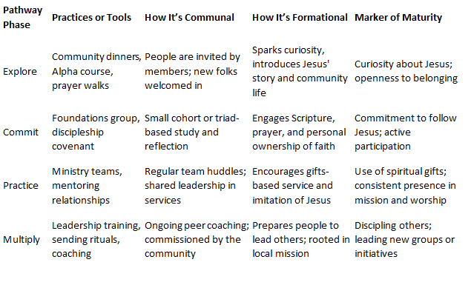
Mapping Your Pathway Framework
Notes:
“Now we begin moving from vision to structure. This table gives you a way to organize your discipleship journey across four phases: Explore, Commit, Practice, and Multiply.”
Explore
Entry points: relational events, open groups, casual invitation
Focus on belonging, curiosity, and movement toward Jesus
Commit
Helping people articulate faith, join community, and adopt core rhythms
Could include covenant groups, baptism prep, or beginner discipleship
Practice
Habits of mission, prayer, and leadership
Service in and outside the church; applying theology in real life
Multiply
Equipping others to disciple, lead, and shape new communities
Ongoing coaching, reflection, and sending practices
Columns:
Practices or Tools: What specifically happens at each phase?
How It’s Communal: How is it experienced in relationship?
How It’s Formational: What transformation are you aiming for?
Marker of Maturity: What fruit shows the phase is bearing results?
“This framework helps you avoid building for content alone—and helps you see the whole arc of discipleship in your community.”

Slide 17
Next Steps:
Complete the tool for developing a local discipleship pathway.
Read Section 3 and bring your completed chart to the next session, July 17th.
Notes:
Next Webinar July 17th – bring your draft of your pathway for processing. (Show example on next slide)
Chapter 7 digs into change strategies
We look forward to our time together at the upcoming New Wine Skins where we will be sharing change management tools.

